Slide 1
Fundamentals and Methods of Computer Science
Exercise week 7

Slide 2
Today’s Menu
Group Project Pitches
Discussion of assignment 6 and the respective quiz
Brief summary of last week’s content
Brief summary of skills necessary to solve assignment 7
Working on assignment 7

Slide 3
Discussion of Assignment 6

Slide 4
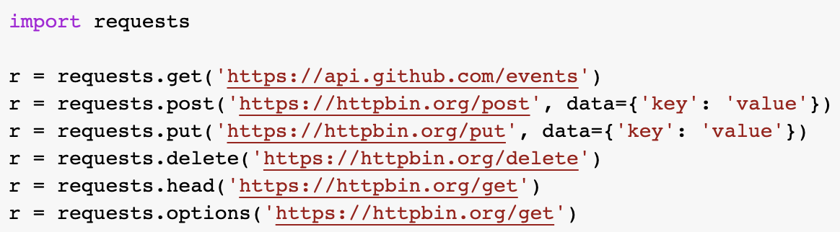
Python Library: requests 1/2
requests
.json method
Interact with web services & APIs by sending HTTP requests…
import requests
url = "https://httpbin.org/get"
r = requests.get(url)
…and receiving HTTP responses:
print(r) > <Response [200]>
print(r.status_code) > 200
print(r.raw) > <urllib3.response.HTTPRes…
print(r.text) > {"args": {}, "headers": {"Acc…
print(r.content) > b'{\n "args": {}, \n "header…
All of these methods have a use-case, however for us they are not all equally easy to read and understand.
A common response format for data is JSON, which is easy for humans & machines to read and write.
To properly work with such data we need to parse it into a suitable python data structure – a dictionary.
content = r.json()
Remember that you can access elements in a dictionary with their key. E.g. you can access the url with the key 'url' or the header host with the nested keys 'headers’ & 'Host'.
content['url'] > 'https://httpbin.org/get’
content['headers']['Host'] > 'httpbin.org'

Slide 5
Python Library: requests 2/2
Parameters
Headers
You can send parameters in an HTTP request. The name of the variables link or parameters does not matter, but the types, keys in parameters and in the function the parameter params do.
link = "https://httpbin.org/get"
parameters = {"user": "uname", "pw": "Test"}
r = requests.get(link, params=parameters)
If you inspect the response, you can see, that the link you sent your request to has been modified by the library:
content = r.json()
content['url']
The url now includes a ? together with your key=value pairs and separated by &:
> 'https://httpbin.org/get?user=uname&pw=Test'
You can also define headers in an HTTP request. Usually done by the requests library this is important for authorization where you modify part of the headers the requests functions send. link = "https://httpbin.org/bearer"
bearer_key = {"Authorization": "Bearer 123"}
r = requests.get(link, headers=bearer_key)
If you inspect the response, you can see, that it worked:
content = r.json()
content
> {'authenticated': True, 'token': '123’}
Again the variable names do not matter but the rest does.
Note that the value in the bearer_key dictionary consists of "Bearer " + "key".

Slide 6
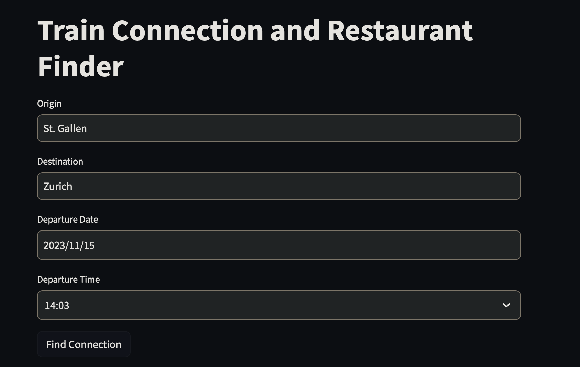
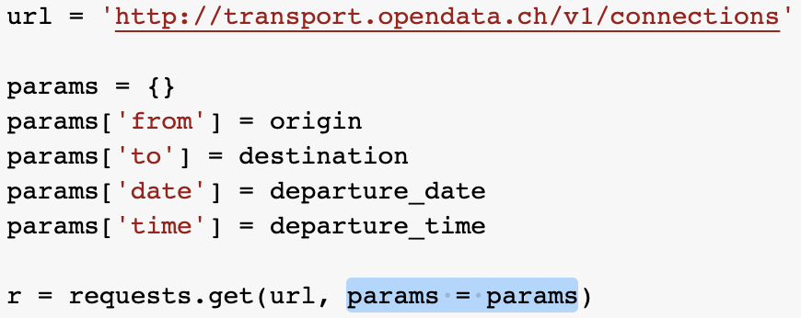
A simple Streamlit implementation of Assignment 6
Based on the code from Assignment 6 as basis with some small tweaks and extensions
Implements streamlit components in app.py which use the functions from the Assignment to provide the required functionality
Uses session state to store connections and restaurants
Uses streamlit secrets to store the API_KEY in a secure way
Available on Github.
Please refer to the README for set-up instructions

Slide 7
Discussion of Quiz 6

Slide 8

Question 1
Reasoning:
The network protocol does influence the security (e.g., UDP/TCP)
Flexibility is one of the advantages of this mechanism
Efficiency and Interoperability between different mediums are key aspects of this design choice
The physical medium does influence the transmission speed (Analogy: light travels at different speed in the space and in water.)

Slide 9
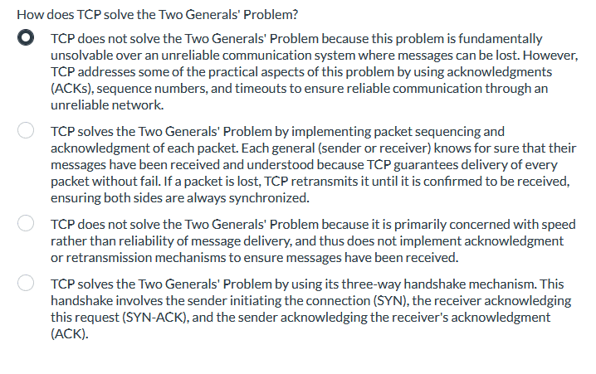
Question 2
Reasoning:
The Two Generals’ Problem cannot be solved over an unreliable netwrok and was one of the first computer communication problem to be proved unsolvable. Only practical measures can be taken to mitgate some of the issues when communication over an unreliable link.

Slide 10
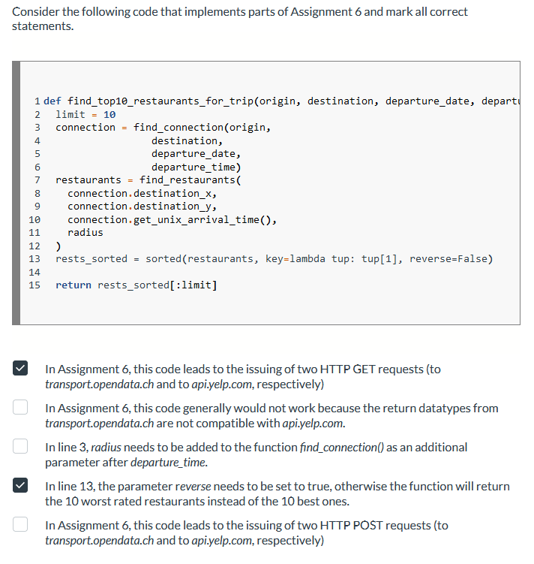
Question 3
Reasoning:
The find_connection and find_restaurants functions both use HTTP GET requests
Both return JSON objects which are deserialized for further use
The radius is only needed for restaurants in the area
By default the sorted function will return the results in ascending order (i.e. lowest ratings first) therefore we need to reverse it
HTTP GET requests are used to retrieve information (some APIs may deviate form this), not HTTP POST requests

Slide 11
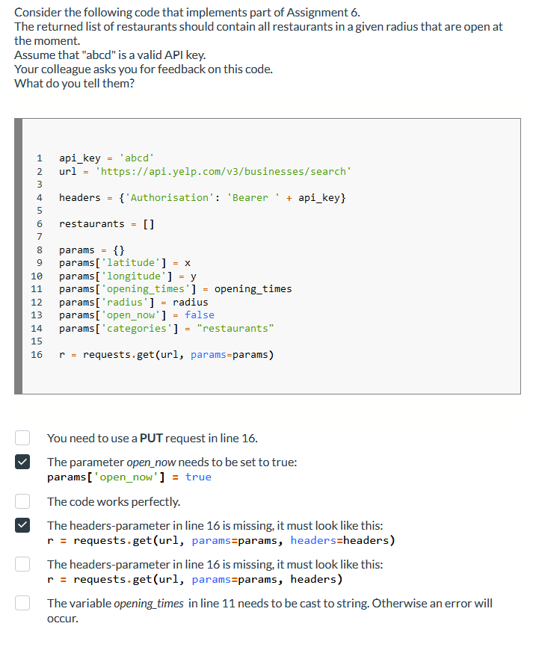
Question 4
Reasoning:
A PUT request would be used to update something, not to retrieve information (if using a standard API implementation)
The task states that only currently open restaurants should be displayed
As outlined in B and questions further below there are some issues with the implementation
If using Bearer Keys for authentication, they have to be sent in the request header
A positional argument cannot follow a keyword (named) argument
Opening times are not needed for the task since we are already filtering out restaurants that are currently closed

Slide 12
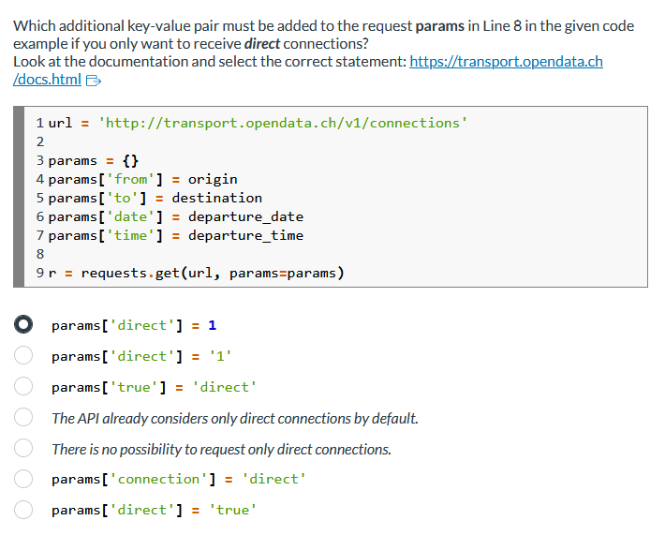
Question 4
Reasoning:
Per API specification the parameter direct has to be supplied as integer (0 if indirect connections are allowed, 1 if only direct connections should be considered). It is an optional argument, if no value is supplied it defaults to 0.

Slide 13
Brief summary of last week’s content

Slide 14
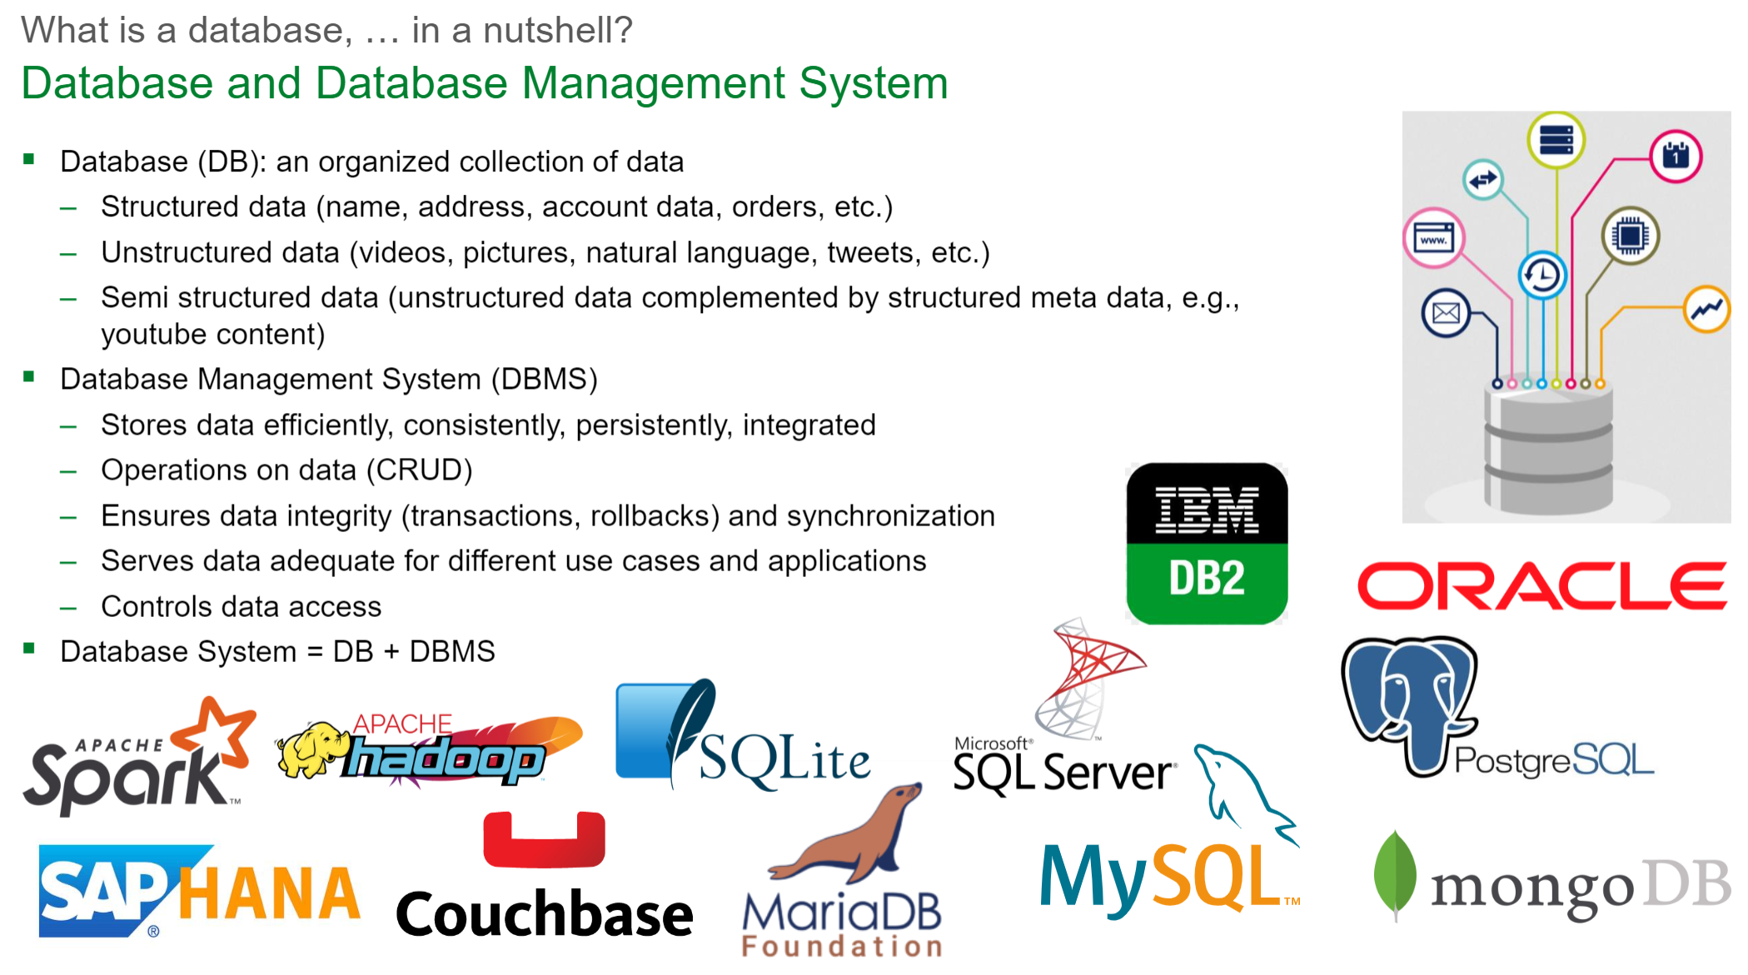

Slide 15
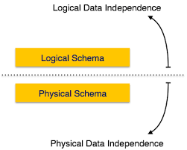
Data Independence (Edgar F. Codd, 1970) & Why Tables?
Data independence: Logical view on data cleanly separated from its physical storage.
Why Tables: Codd suggested that the most natural logic view on data is in form of a table, because everybody understands them.
What do these things mean for us: Users should only see relational tables when interacting with a database, the physical implementation is hidden → level of abstraction (user does not care about).
More Formal: A relational database management system (RDBMS) exposes this logical model, together with logical building blocks for manipulating it (logical layer), on top of a physical layer.

Slide 16
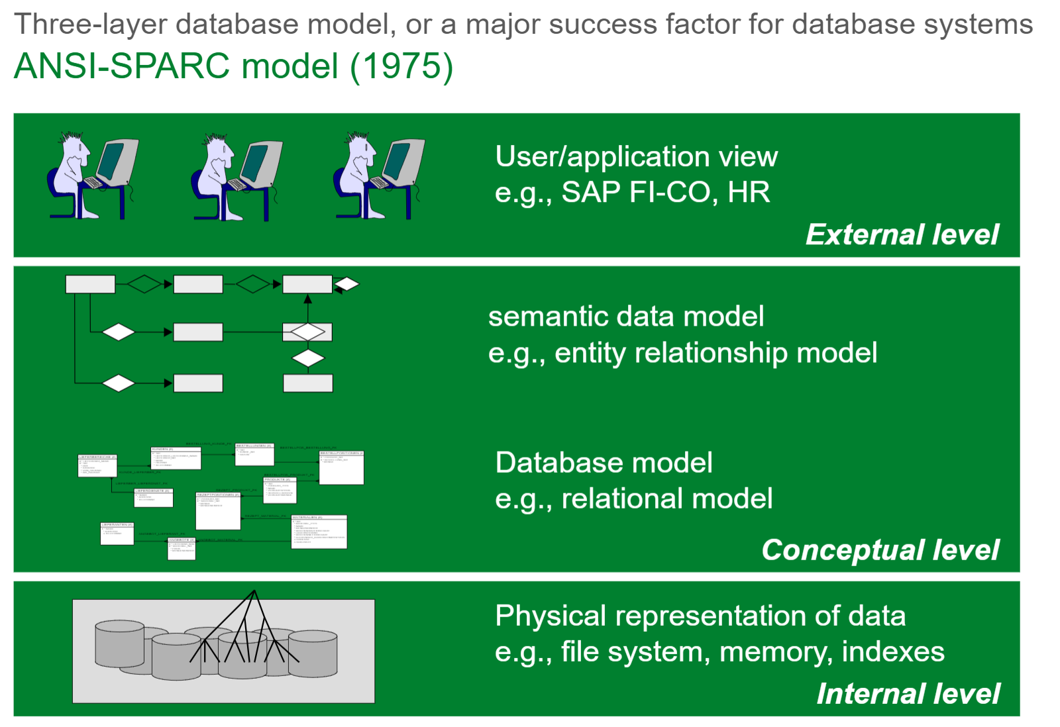

Slide 17
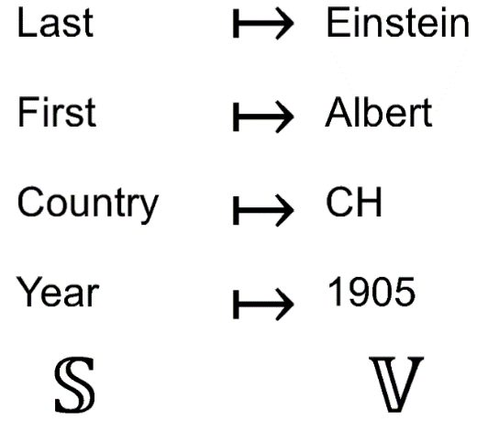
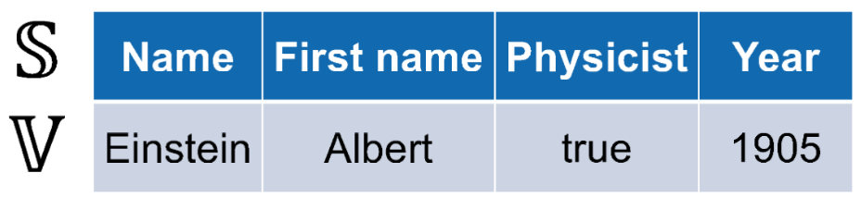
What are Tables?
A relation R consists of:
a set of attributes [«headers»]
an extension (set of tuples) [«rows»].
Collection of records C = P(S → V) (“set of partial functions S(trings)→V(alues)”)
Record f = mapping (“partial function”)
Represented differently
(implicity mapping through order)
Name | First name | Physicist | Year
Einstein | Albert | true | 1905
f(“Name”) = “Einstein” | f(“First name”) = “Albert” | f(“Physicist”) = true | f(“Year”) = 1905 | f undefined for any other S
f_{Name} = “Einstein” | f_{“First name”} = “Albert” | f_{Physicist} = true | f_{Year} = 1905 | f undefined for any other S

Slide 18
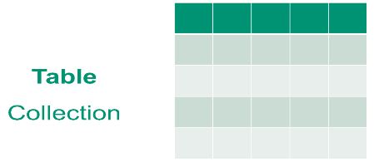
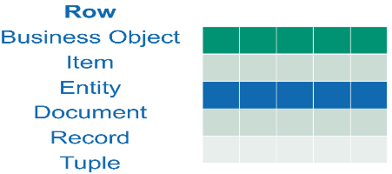
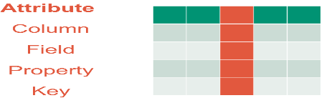
Tables = Collections of records
Table: A collection of records (e.g. in an employee table all employees, in a product table all products).
Row: A record in a collection, that associates properties with the values applicable for the record it represents (e.g. one person, one product).
Attribute: A property that records can have (e.g. person’s last name, product’s price).

Slide 19
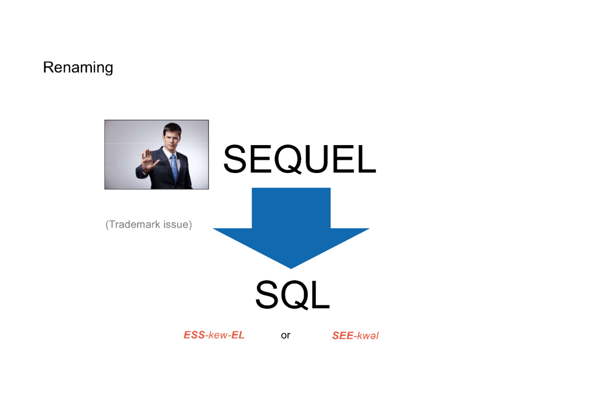
SQL or SEQUEL?
SEQUEL
(Structured English QUEry Language)
first commercial relational query language

Slide 20
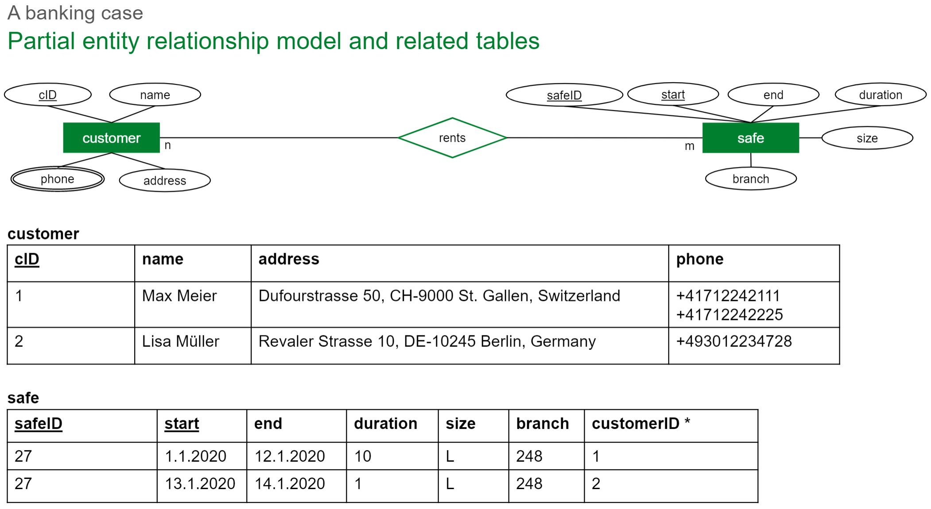
SQL (a relational database model created 1970)

Slide 21
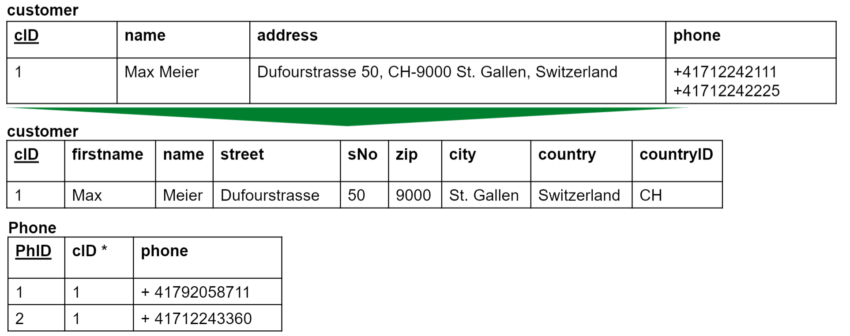
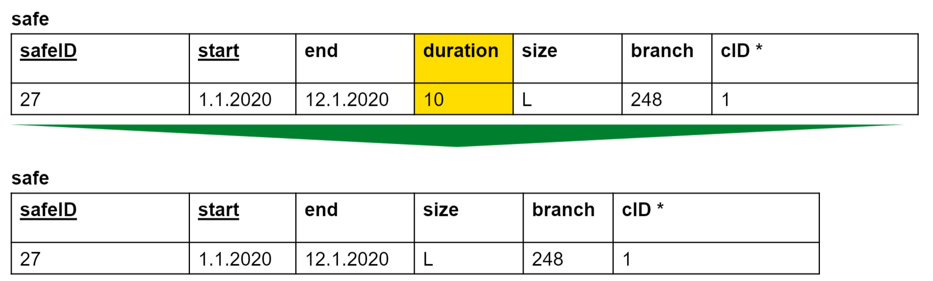
Normalization (First normal form – 1NF)
A relation is in first normal form, if
There are atomic attributes only
There are no repeated attributes
There are no derived attributes
→ No nestedness

Slide 22
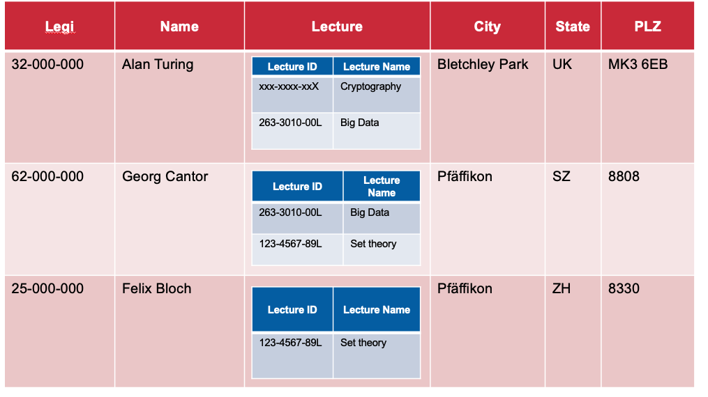
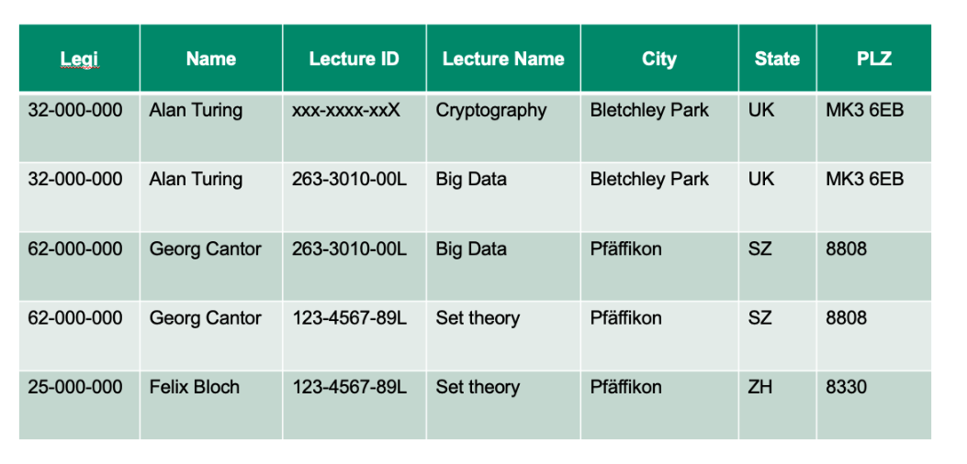
Normalization (First normal form – 1NF)

Slide 23
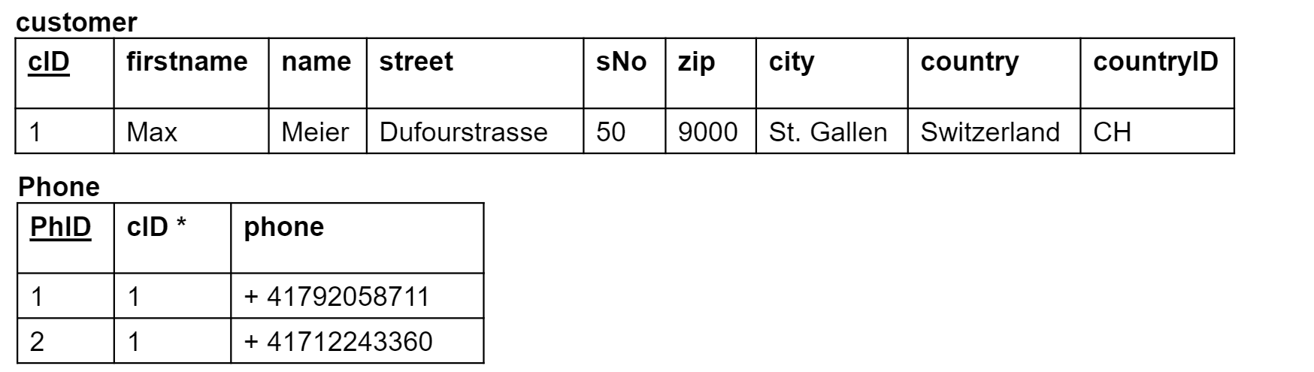
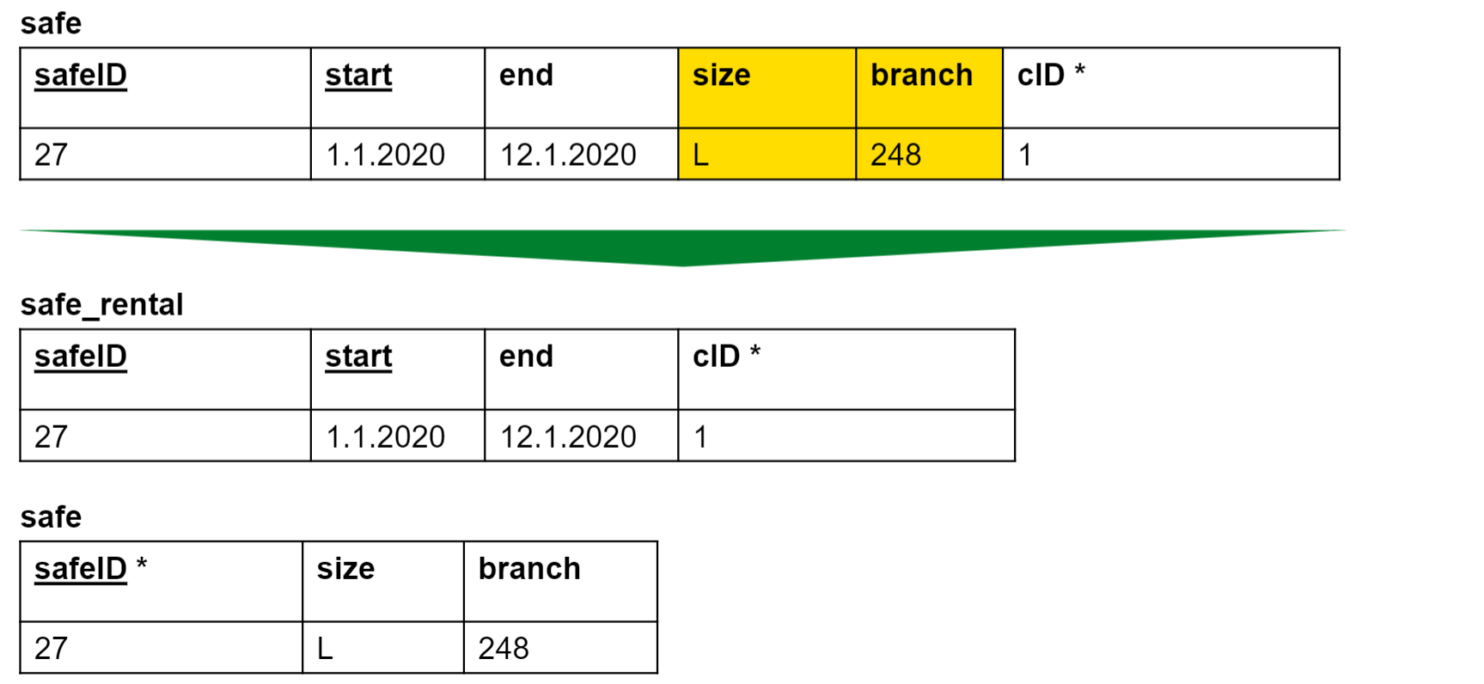
Normalization (Second normal form – 2NF)
A relation is in second normal form, if
It is in first normal form
every non-key attribute is fully functional dependent on the entire key – not on key components only
→ Each column contains
information on the entire record

Slide 24
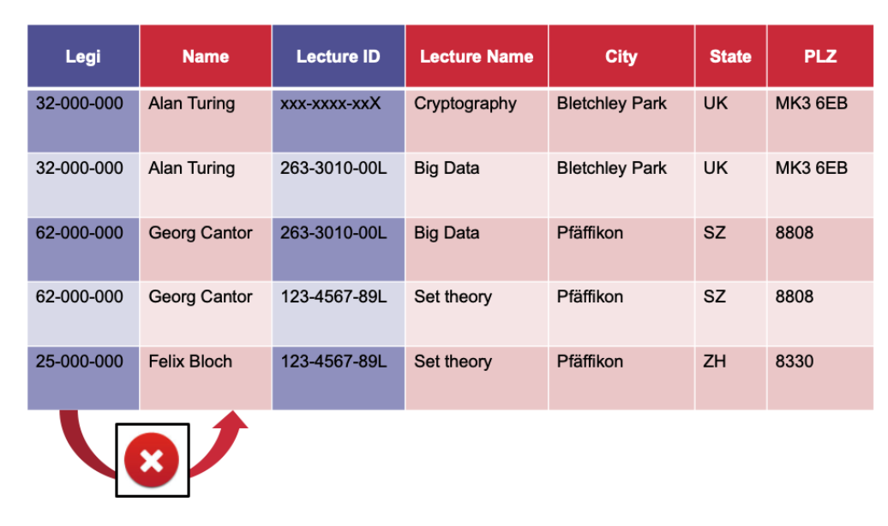
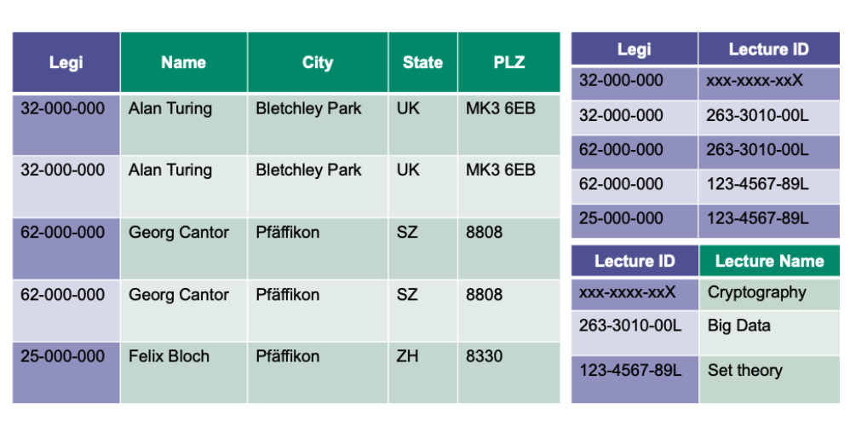
Normalization (Second normal form – 2NF)

Slide 25
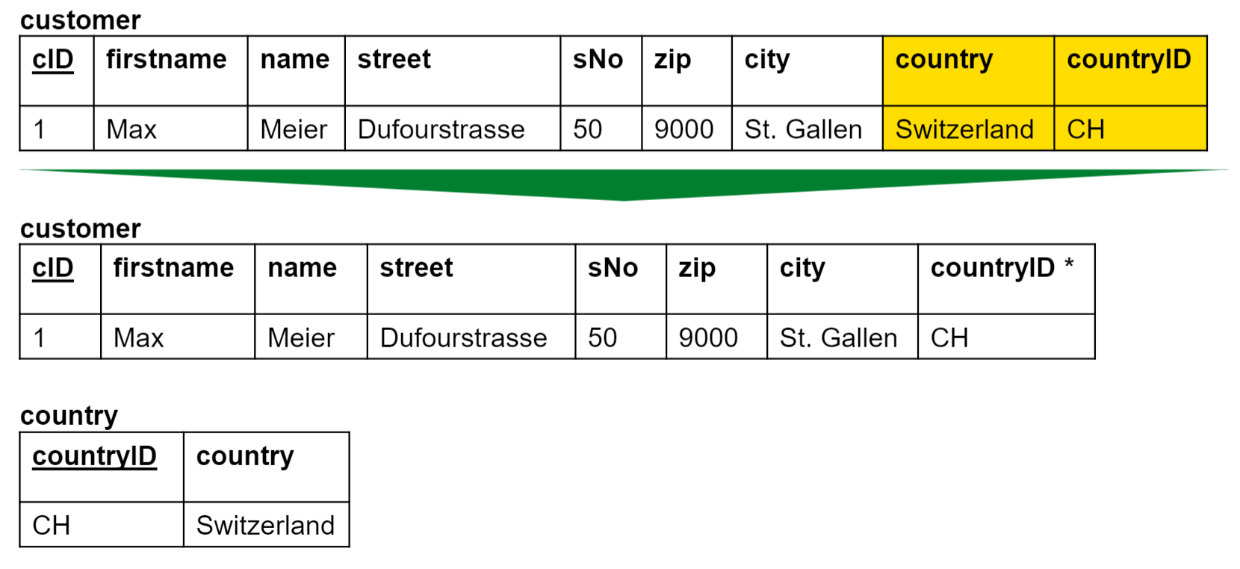
Normalization (Third normal form – 3NF)
A relation is in third normal form, if
It is in the second normal form
There are no dependencies between non-key attributes (transitive dependencies on the key)
No functional dependencies
except with primary keys

Slide 26
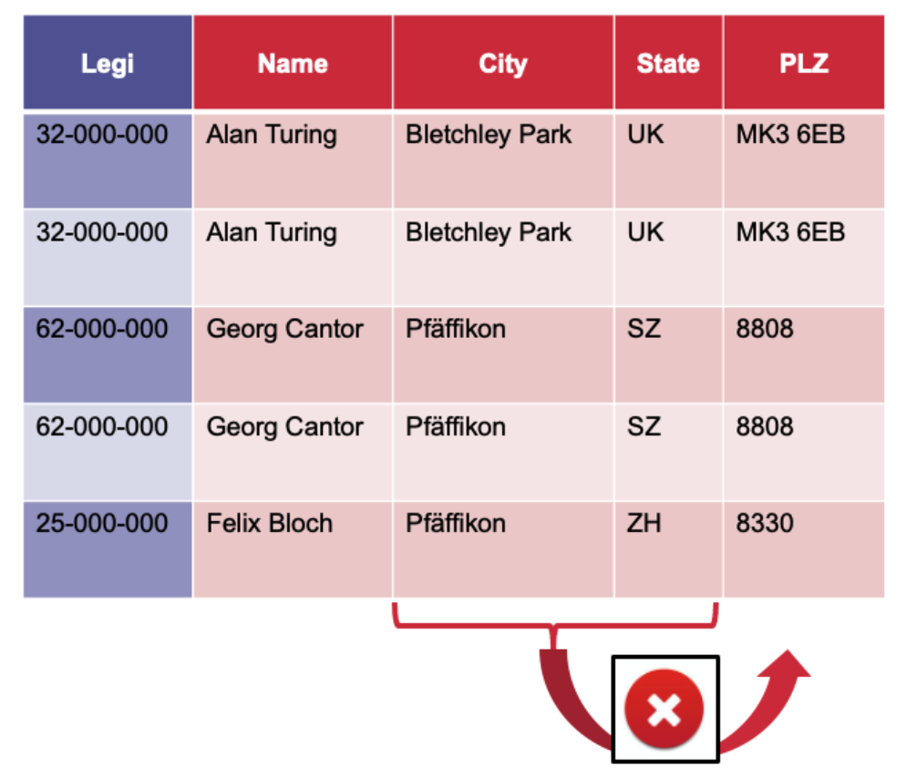
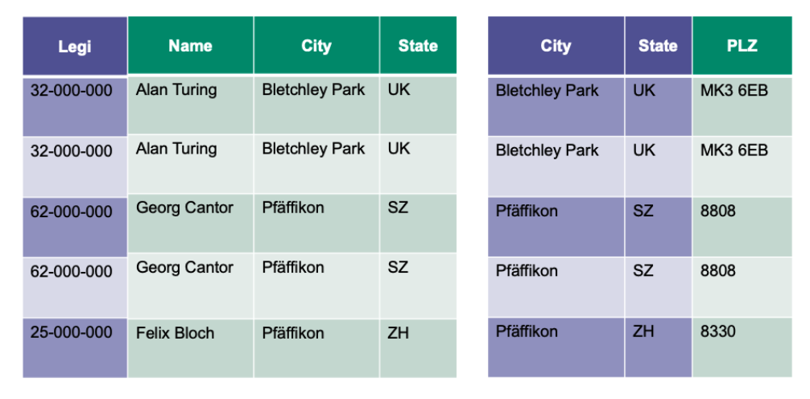
Normalization (Third normal form – 3NF)

Slide 27
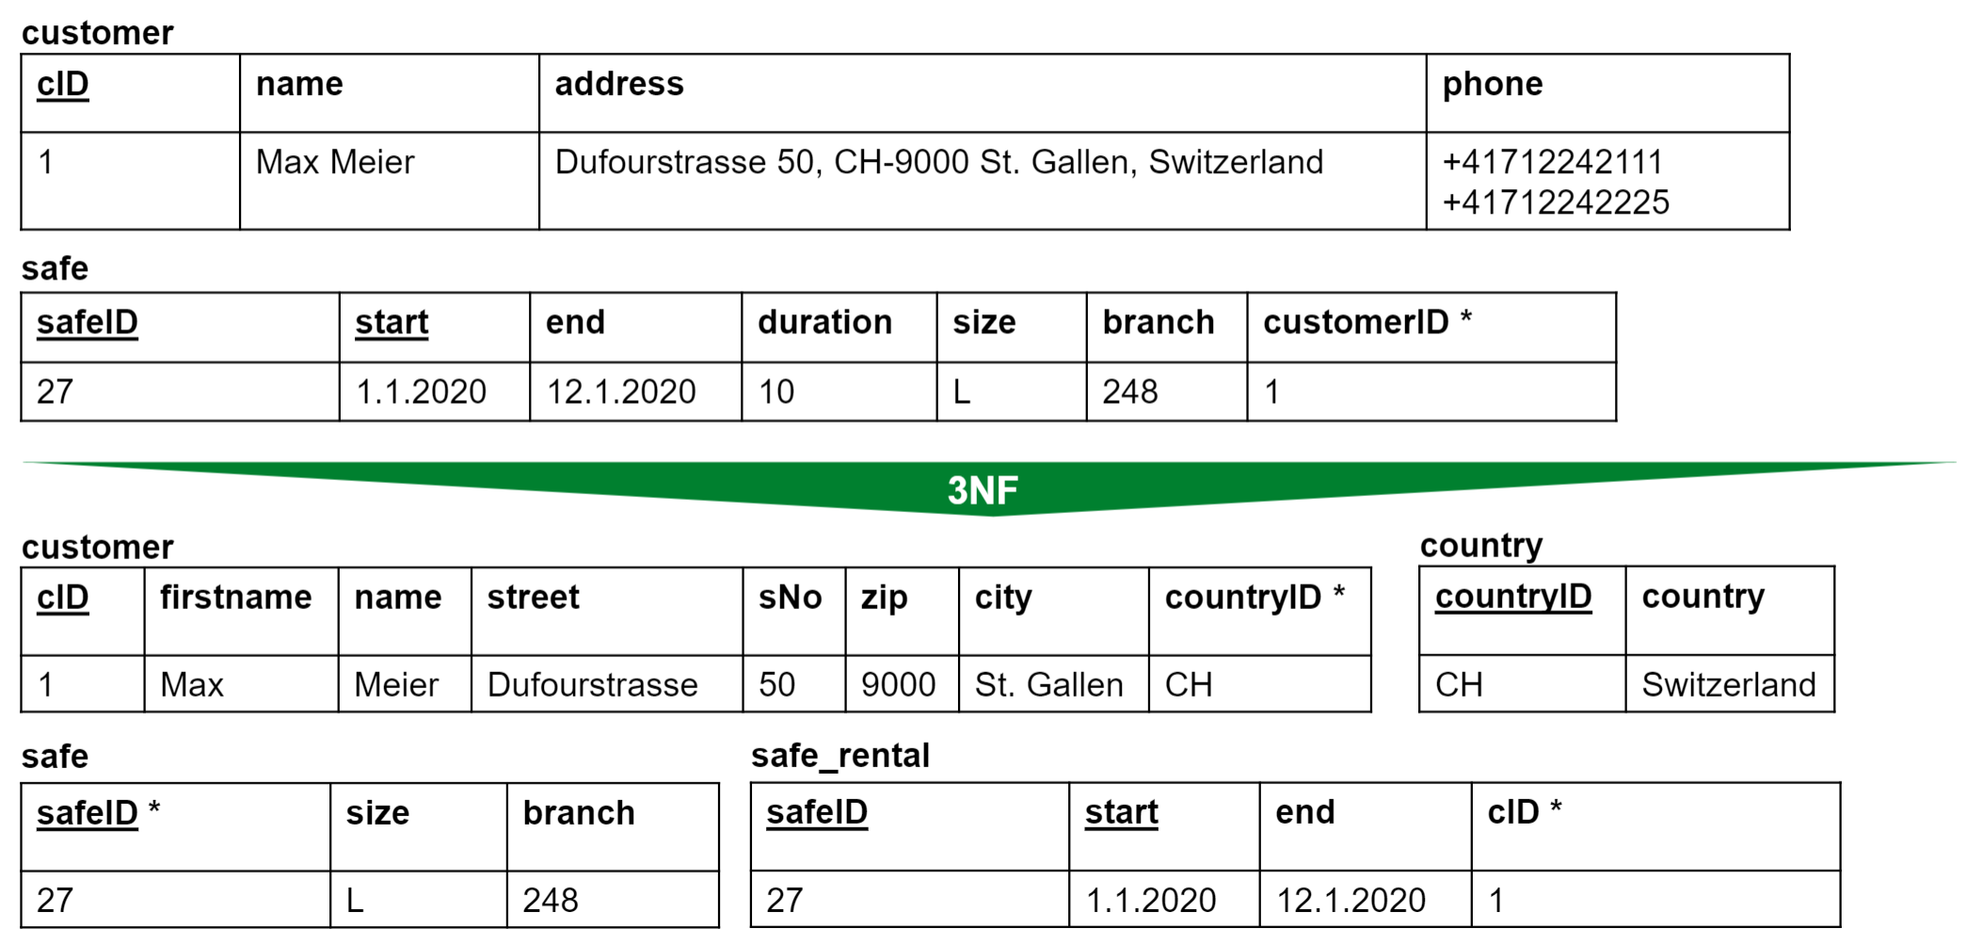
Normalization (Summary)
There are more than 3 normal forms, but 3NF is usually enough.

Slide 28
Brief summary of skills necessary to solve Assignment 7

Slide 29
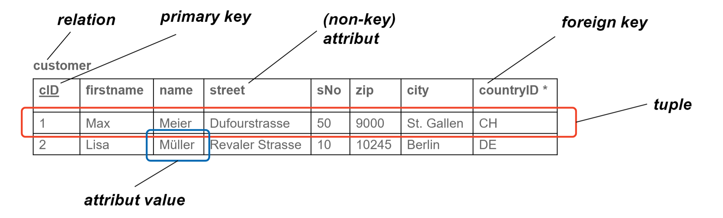




Key Terms
Tables

Slide 30

Introduction to SQL
Structured Query Language (SQL)
Structured Query Language (SQL)
Structured Query Language (SQL) is a language for storing, manipulating and retriving data in data bases.
You can think of a query like a question or a request for data. For example: «Tell me how many people there are in the table authors»
Example
Steps
Defines index column (optional)
String representing SQL query to execute
Connection object
Index_col keyword argument indicating which column should be used as the dataframe’s row indices (when an index_col is not passed the index values starting from 0 appear to the left of the dataframe’s rows)
Query
Database (Name)

Slide 31
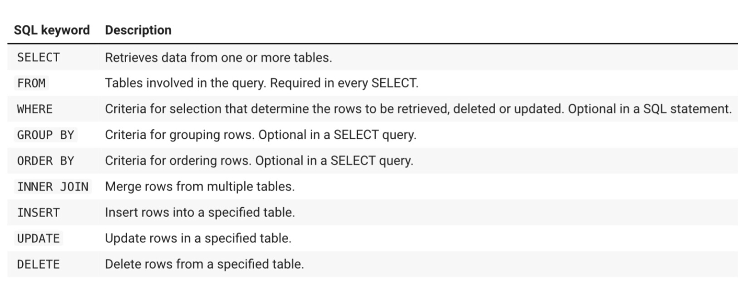

SQL Keywords
Structured Query Language (SQL)
Example

Slide 32
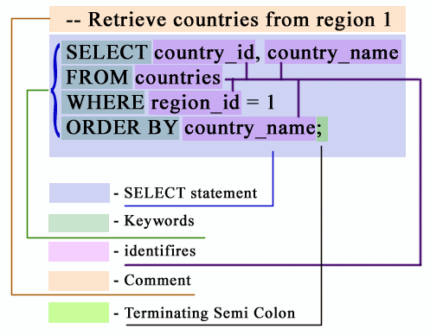
Query Syntax in 1 Slide
Structured Query Language (SQL)
https://www.w3resource.com/sql/sql-syntax.php

Slide 33
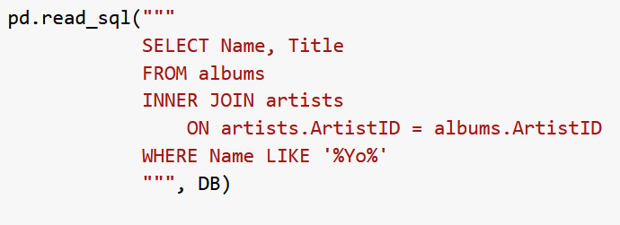
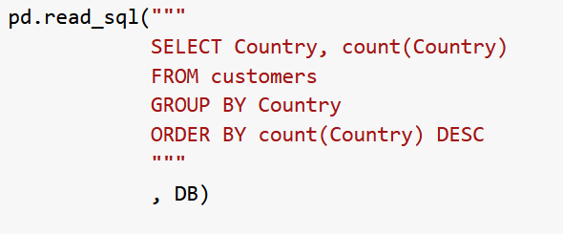
Inner Join & Group By
Structured Query Language (SQL)
INNER JOIN
GROUP BY
Example
Example
Inner join joins two tables in such a way that only the «common» rows appear in the final table.
% represents 0 or more characters → ‘%Yo% finds everything that includes a ‘Yo’
Group by statments group rows that have the same value in a certain column into «summary rows»

Slide 34

Question Mark
Structured Query Language (SQL)
Example
The value inside the tuple (10) will be «placed» where the question mark is located.
Params must always be a tuple: params = 10 → wrong, params = (10) → correct
There can be multiple ? → the first questionmark to appear in the string will take the first value in the tuple and the second one will take the second value inside the tuple.

Slide 35
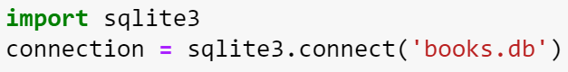
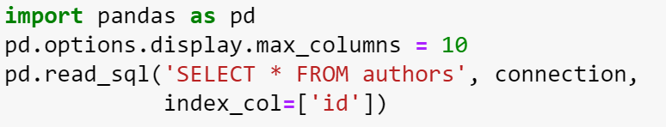


Using SQL in Python 1/2
Connecting to an existing database in Python
Using pandas («creates a cursor») to view a DataFrame for a table
It is common practice to use uppercase keywords, but it is not necessary!

Slide 36

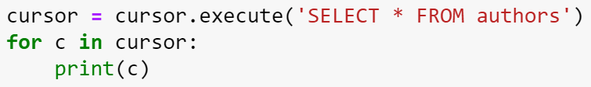



Using SQL in Python 2/2
Creating a Cursor to Insert / Delete data
Closing the database

Slide 37
Now you have everything you need to start with Assignment 7

Slide 38
Dominik Buchegger
dominik.buchegger@student.unisg.ch

